Slide 1
Named Calls

Slide 2


Welcome!
Notes:
ON SCREEN
Welcome back! In this video we will look at some additional OS concepts such as Named Calls, including Procedure and System calls. Let’s get started!
[CLICK – Next Slide]

Slide 3




System Resources
!
We’ll look at each of these in this class!
The OS is responsible for managing:
CPU time
Working memory
Storage
Device input and output (I/O)
Notes:
OFF SCREEN
As mentioned in previous videos, the OS manages system resources such as [CLICK]
The CPU time allocated to each process running in the system [CLICK]
Working memory (or main memory) [CLICK]
Storage (fixed / removable disks or SSDs) [CLICK]
Device Input and Output such as keyboards, monitors, etc. [CLICK]
In the next sections, we will look at each of these in detail in this class!
[CLICK – Next Slide]

Slide 4
Key Concepts
1
Files
Logically named persistent storage
Also, a paradigm for I/O devices, communication
2
Process
Program in execution
Not the same as a program
Notes:
ON SCREEN
Two key concepts in OSs are Files and Processes. [CLICK]
Files are logically named persistent storage. These may be our text, video or audio files, for example. [CLICK]
Another use for files is as a paradigm for I/O devices and data communication. We will look at these when we talk about process communication strategies. [CLICK]
A process on the other hand, is a program in execution.
Let’s explore a little more of both:
[CLICK – Next Slide]

Slide 5
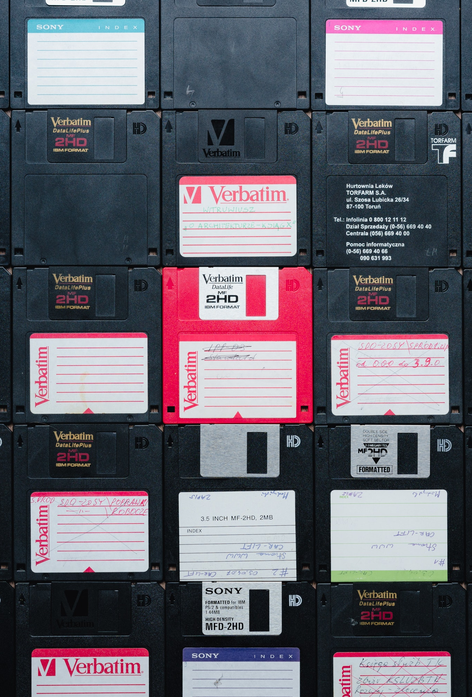
File Storage
Operating systems facilitate storage of data via File Systems.
File systems:
Pattern to the arrangement of data on disk
Have a mounting scheme (C:\, /mnt/disk, etc.)
Usually involve a naming and directory system
Other possible features:
Redundancy
Networking
In modern systems, we don't read directly from the disc.
!
Notes:
OFF SCREEN
Operating systems facilitate storage of data via File Systems [CLICK]
File systems define how data is stored (for example on a magnetic disk or solid state drive (SSD)) [CLICK]
File systems typically have mounting schemes: how are different disks identified inside the OS? In windows Oss disks are identified by letters, such as C. On Unix systems, they appear as directories, and usually appear inside the mnt (mount) directory. [CLICK]
File systems implement strategies to name files and to store them in folder or directory trees. [CLICK]
Besides these basic attributes, file systems also may provide advanced features such as data redundancy and networking capabilities. [CLICK]
One important aspect to note is that In modern systems, we don't read directly from the disc.
To read from a disk, a process politely asks the OS for that operation by issuing a system call.
Application programs make a system call that is then passed to the OS in kernel mode. The OS treats the call, executes the disk access and returns the requested information to the application program.
[CLICK – Next Slide]

Slide 6
Programs & Processes & Threads, Oh My!
Process Tree Example
A
B
C
When we run a program (list of instructions), we create a process for it.
D
E
F
Thread Example
A process:
Is a running program (in execution)
Has some address space
Is associated with specific resources (container)
Has one or more threads of execution
data
files
data
files
registers
stack
registers
registers
registers
stack
stack
stack
code
code
Notes:
OFF SCREEN
Now let’s talk about processes. [CLICK]
When we run a program (list of instructions), we create a process for it in main memory.
The OS, via the scheduler, moves processes from memory to the CPU so that they can be executed. [CLICK]
A process is a program in execution, it occupies some address space, it is associated with specific resources (data, stack, pointers, and files). [CLICK]
Processes are organized in trees. Each process has a parent and may have one or multiple children. [CLICK]
Each process may also have one or multiple threads of execution. We will talk more about threads later.
For now, just know that threads are a way to save memory when you need multiple processes executing the same set of instructions.
[CLICK – Next Slide]

Slide 7
Key Concepts
Named Calls
1
Procedure Calls
2
System Calls
Notes:
ON SCREEN
Now, let’s look closely at Named Calls. [CLICK]
Named calls are divided into Procedures and System Calls.
First, let’s look at Procedure Calls.
[CLICK – Next Slide]

Slide 8
Named Calls: Procedure Calls
Procedures are named code with:
Local variables
Parameters, passed by:
Value (5)
Reference (memory address of 5)
Name (var_5)
Pointer to entry/return
Here function = procedure
Typically, a function does not change input parameters, being a special case of procedures.
Notes:
OFF SCREEN
Procedures are named code with: [CLICK]
Local variables [CLICK]
Parameters
passed by value, by reference (memory address), by name [CLICK]
Pointer to entry/return
If you have programmed, you have, most likely, created a function or a procedure. [CLICK]
In this course, we will consider functions as being the same are procedures. [CLICK]
Typically, a function does not change input parameters, being a special case of procedures. For our purposes, we will not make this distinction.
For us, any procedure call is a named call that executes completely in User Space in the OS.
[CLICK – Next Slide]

Slide 9
Process Memory Layout
Segments of a process in memory
Address (hex)
1
Text
FFFF
Stack
Code the process is executing
Gap (free space)
2
Data/heap
Static and dynamic
Data/heap
3
Stack
Text
Activation frames of the calls made (e.g., in recursion)
0000
Notes:
OFF SCREEN
To further understand procedure calls, let’s look at how processes are arranged in memory.
The image shows that arrangement.
These are the segments of a process in memory: [CLICK]
Text: (code the process is executing) [CLICK]
Data: static and dynamic variables and other structures (for example arrays and vectors) [CLICK]
Stack: activation frames of the calls made (e.g. when a procedure or function is called)
Note that allocated memory for Data grows up in the memory space, while memory allocated in the stack grows down in the memory space.
Memory for the process is allocated so that there is empty (Gap) memory for the data and stack to grow.
[CLICK – Next Slide]

Slide 10
Named Calls: Procedure Calls
When we make a procedure call (function call), we add a stack frame to the call stack.
…
0x6474
…
…
0xcafe
…
…
0xf00d
…
int dubdub(int life)
{
return life;
}
int lubba()
{
return dubdub(42);
}
int wubba()
{
printf("%d", lubba());
}
Notes:
OFF SCREEN
Now let’s see what happens when we make a procedure (or function) call.
When we make a procedure call (or function call), we add a stack frame to the call stack: [CLICK]
In the example, we are inside the procedure called lubba(), and we are calling the procedure dubdub, passing the number 42 by value.
[CLICK – Next Slide]

Slide 11
Named Calls: Procedure Calls
Current Stack Frame
Begins at the Frame Pointer and ends at the Stack Pointer.
…
0x000f
…
…
0x200e
0x200f
…
…
0x300f
Previous Frame (wubba)
…
0x6474
…
…
0xcafe
…
…
0xf00d
…
int dubdub(int life)
{
return life;
}
int lubba()
{
return dubdub(42);
}
int wubba()
{
printf("%d", lubba());
}
Frame Pointer (FP)
Current Frame (lubba)
Stack Pointer (SP)
Stuffs
Garbo
Junk
Other Stuffs
More Garbo
Additional Junk
…
…
Notes:
OFF SCREEN
Note that while inside lubba, the stack frame of that procedure is well defined in memory, with a frame pointer (FP) pointing to the beginning of the frame and the stack pointer(SP) pointing to the end of the frame. [CLICK]
Below the current frame (lubba) there is memory that has not been allocated. That space is usually not clean (or filled with zeros, for example), it has invalid, garbage data, as represented in the image.
[CLICK – Next Slide]

Slide 12
Named Calls: Procedure Calls
Copy call arguments
…
0x000f
…
…
0x200e
0x200f
…
…
0x300f
Previous Frame (wubba)
…
0x6474
…
…
0xcafe
…
…
0xf00d
…
int dubdub(int life)
{
return life;
}
int lubba()
{
return dubdub(42);
}
int wubba()
{
printf("%d", lubba());
}
Frame Pointer (FP)
Current Frame (lubba)
Stack Pointer (SP)
Call Arguments(42)
Garbo
Junk
Other Stuffs
More Garbo
Additional Junk
…
…
Notes:
OFF SCREEN
Once a procedure call is called, information is added to a new frame in the stack. For example, the call arguments are copied.
[CLICK – Next Slide]

Slide 13
Named Calls: Procedure Calls
Add other information to the stack
…
0x000f
…
…
0x200e
0x200f
…
…
0x300f
Previous Frame (wubba)
…
0x6474
…
…
0xcafe
…
…
0xf00d
…
int dubdub(int life)
{
return life;
}
int lubba()
{
return dubdub(42);
}
int wubba()
{
printf("%d", lubba());
}
Frame Pointer (FP)
Current Frame (lubba)
Stack Pointer (SP)
Call Arguments(42)
Return addr. (0xcafe)
Prev. Frame Pointer (0x000f)
Local vars. (for dubdub)
Temporaries
Saved Registers (prev)
…
…
Notes:
OFF SCREEN
That is followed by several other data, for example: the return address – so it knows where to return to when the new procedure returns, the previous frame pointer, local variables, register info.
In essence, the new frame will have all the information it needs to execute (call arguments) and all the information it needs to go back to the procedure that called it.
[CLICK – Next Slide]

Slide 14
Named Calls: Procedure Calls
Change Stack Frame
Begins at the Frame Pointer and ends at the Stack Pointer.
…
0x000f
…
…
0x200e
0x200f
…
…
0x300f
Previous Frame (wubba)
…
0x6474
…
…
0xcafe
…
…
0xf00d
…
int dubdub(int life)
{
return life;
}
int lubba()
{
return dubdub(42);
}
int wubba()
{
printf("%d", lubba());
}
Current Frame (lubba)
Frame Pointer (FP)
Call Arguments(42)
Return addr. (0xcafe)
Prev. Frame Pointer (0x000f)
Local vars. (for dubdub)
Temporaries
Saved Registers (prev)
Stack Pointer (SP)
…
…
Notes:
OFF SCREEN
After the new stack frame has all the information it needs, the frame pointer and stack pointer are moved, and now point to the new frame. [CLICK]
The called procedure (dubdub) can now be executed.
This completes our overview of procedure calls.
We now have a good understanding of how the stack is populated when a procedure is called.
[CLICK – Next Slide]

Slide 15

Key Concepts
Named Calls
1
Procedure Calls
2
System Calls
Notes:
ON SCREEN
Now, let’s take a look at System Calls
[CLICK – Next Slide]

Slide 16

Named Calls
System Calls
User mode
A system call involves a context switch into kernel mode for execution.
Trap
to
Kernel
Usually, there is a system library entry point. (fread, fwrite, …)
Kernel mode
Notes:
ON SCREEN
A system call is a named call that involves a context switch into kernel mode for execution.
System calls are needed to execute protected instructions, such as to read or write from a disk, or allocate memory. [CLICK]
Usually, there is a system library entry point.
For example, fprintf and malloc in C++ implement system calls – they are system library entry points.
[CLICK – Next Slide]

Slide 17
System Calls and System Library
The user program calls System Library. Similar to a procedure call
User Space
User Program
Inside the System Library Routines, the System Call is actually made. Parameters and System call numbers are stored by the System Library Routine at specific spaces.
System Library
TRAP to Kernel Context Switch (from user mode to kernel mode)
Trap
OS Dispatcher
Kernel dispatcher reads a SysCall number Looks up vector table, and makes internal call to code that carries out the system call
System Call Code
System Returns to Library
Kernel Space
Library routine returns to user Program
Notes:
OFF SCREEN
To start a system call, the user program calls a System Library procedure, such as fprintf to print or fread, to read from a disk. [CLICK]
Inside the System Library procedure, the system call is made.
To issue a system call, the System Library procedure stores some parameters necessary to run the system call, and a System call number in predetermined memory areas.
Once the parameters and system call number are stored, the system library procedure issues a kernel trap (to kernel mode). [CLICK]
To enter kernel mode, the OS first stores the current address / registers / etc from the previously executing process.
After “removing” the previous process from the CPU, the OS enters kernel mode, and the OS Dispatcher runs. [CLICK]
The dispatcher reads (from memory) the system call number that was previously saved by the System Library Routine and uses that number to look up a vector table that has pointers to code that can carry out each possible system call. The number is used to determine which system call the OS must run.
The dispatcher than executes the selected routine. For example, reading data from a disk. [CLICK]
Once the system call routine is executed by the dispatcher in kernel mode, the system returns to the system library routine, and the OS returns to user mode. [CLICK]
Next, the system library routine (for example fread), returns the result of execution to the user program, for example by returning 0 in case of success or 1 in case of failure.
This completes the cycle of issuing a system call.
[CLICK – Next Slide]

Slide 18
Example System Call: howdy() Calls printf
User Program
int howdy()
{
printf("Howdy howdy howdy. ");
}
User Space
System Library
int printf(const char * format, ...);
{
…
// Setup registers / invoke trap
…
}
Invoke Trap
System Call Dispatcher (Address from SPR)
dispatcher:
# Assembly instructions go here
…
Kernel Space
System Call Kernel Code (Address from Syscall Table)
int kernel_print_routine()
{
…
}
Notes:
OFF SCREEN
To help understanding the system call cycle, we will look at some additional examples. [CLICK]
In this example, the user program is executing a procedure (Howdy()) that calls printf.
Since printf is an I/O operation, and the OS manages IO operations (they are protected instructions!) a system call must happen.
Note that the names of system calls and library calls are not necessarily real. But they illustrate what happens, independently of the language selected. [CLICK]
Like described before, printf (the system library routine) sets the environment for the execution of the system call by setting memory (registers), storing a System Call number, and invoking a kernel trap. [CLICK]
The System Call Dispatcher reads the system call number from memory and selects from a vector which system call routine to execute. [CLICK]
In this case, the routine execute is “kernel_print_routine” – As mentioned this is not a real name, but it gives you the idea.
Once that routive finishes executing, execution is returned to the system library routine (printf), that return the status of execution to the user program.
[CLICK – Next Slide]

Slide 19

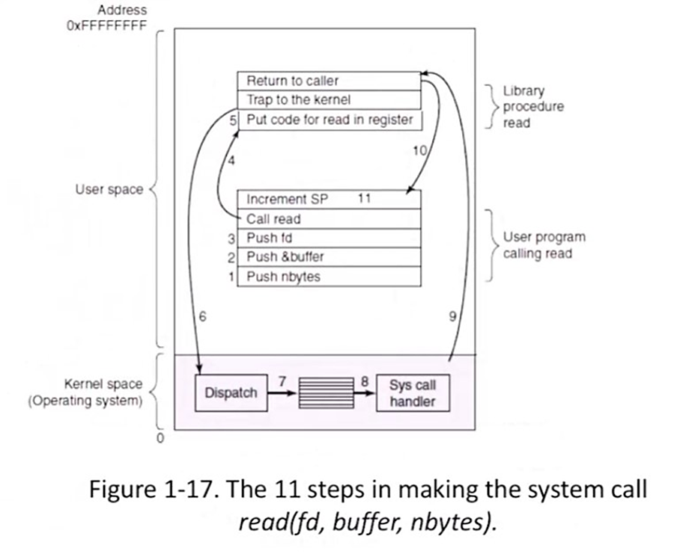
System Call
read(fd, buffer, nbytes)
(Tanenbaum & Bos, 2015)
Notes:
ON SCREEN
This is another representation of the same cycle. This comes right from the book.
This case shows a read system call.
I’ll leave it for you to examine this image. Follow steps from 1 to 11. Pause the video and exam each step.
[CLICK – Next Slide]

Slide 20
Posix System Call Examples
Process Management
Call | Description
fork() | Create child process identical to parent
waitpid(pid, &stat, options) | Wait for a child process to terminate
execve(name, argv, env) | Replace a child core image
exit(status) | Terminate a process / return status
kill(pid, signal) | Send a signal to a process
File Operations
Call | Description
open(file, options, …) | Open a file
close(fd) | Close an open file
read(fd, buffer, count) | Read data from a file into a buffer
write(fd, buffer, count) | Write data from a buffer into a file
lseek(fd, offset, whence) | Move the file pointer
Notes:
OFF SCREEN
Now that we understand what system calls are and how they work, let’s look at some examples.
This list is far from exhaustive, but it contains some common system calls. Importantly, the calls showed here are part of the POSIX standard.
POSIX is a set of formal descriptions that provide a standard for the design of operating systems, especially ones which are compatible with Unix, such as Linux. [CLICK]
Some examples of system calls for process management include fork, to create child processes (that is identical to its parent) and Exit, to terminate a process. [CLICK]
Some examples of system call related to file operations include Open, Close, Read, Write, and Lseek, that are commonly used even in simple programs.
[CLICK – Next Slide]

Slide 21
Takeaways
1
Name calls
Procedure calls
System calls
Notes:
ON SCREEN
I hope this has given you a broad view of Name calls, including procedure calls and system calls.
These are core aspects of how modern operating systems work and represent building blocks future concepts that we will examine in this course.
[CLICK – Next Slide]

Slide 22
Thank You

Slide 23
References
Tanenbaum, A. S. & Bos, H. (2015). Modern Operating Systems (4th ed.). Pearson.

